Slide 1
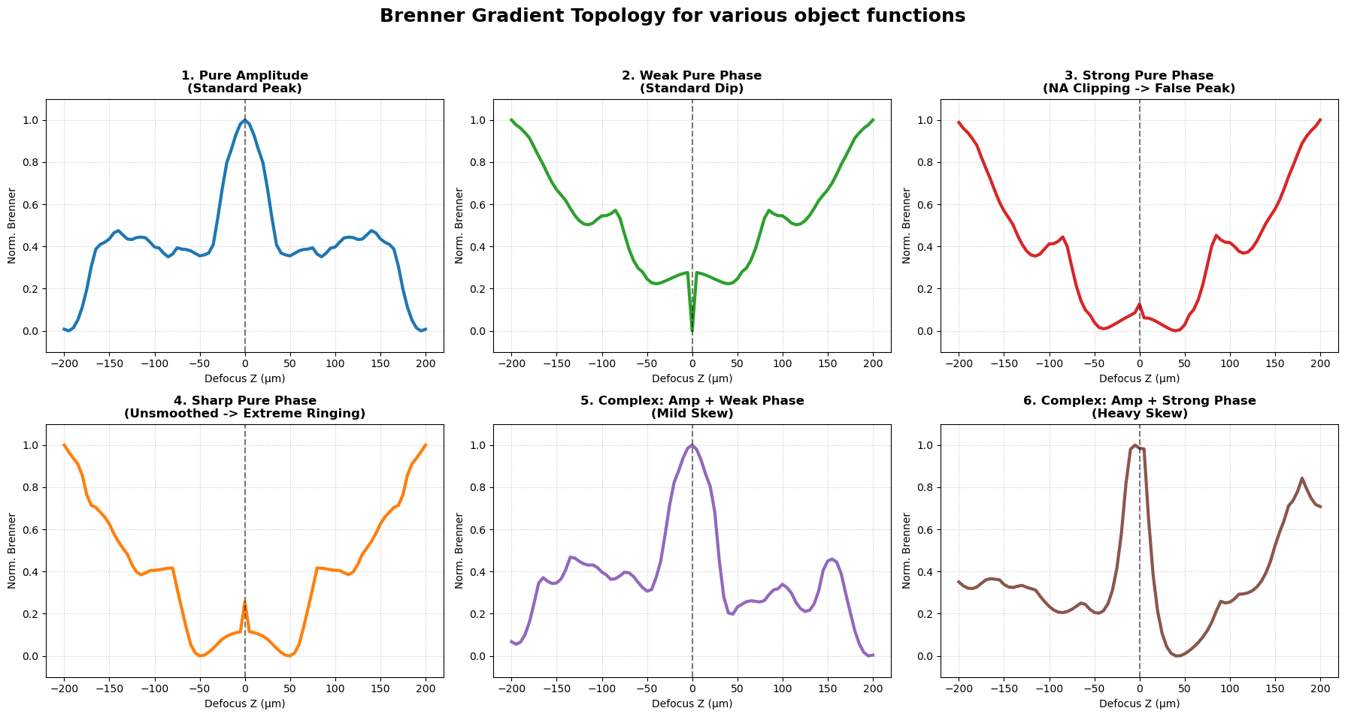

Slide 2
Weak Phase Object
[Phase Inversion]
(b) Complex Object
[Amplitude-Phase Crosstalk]
(c) Strong Phase Object
[Gibbs Anomaly]

Slide 3
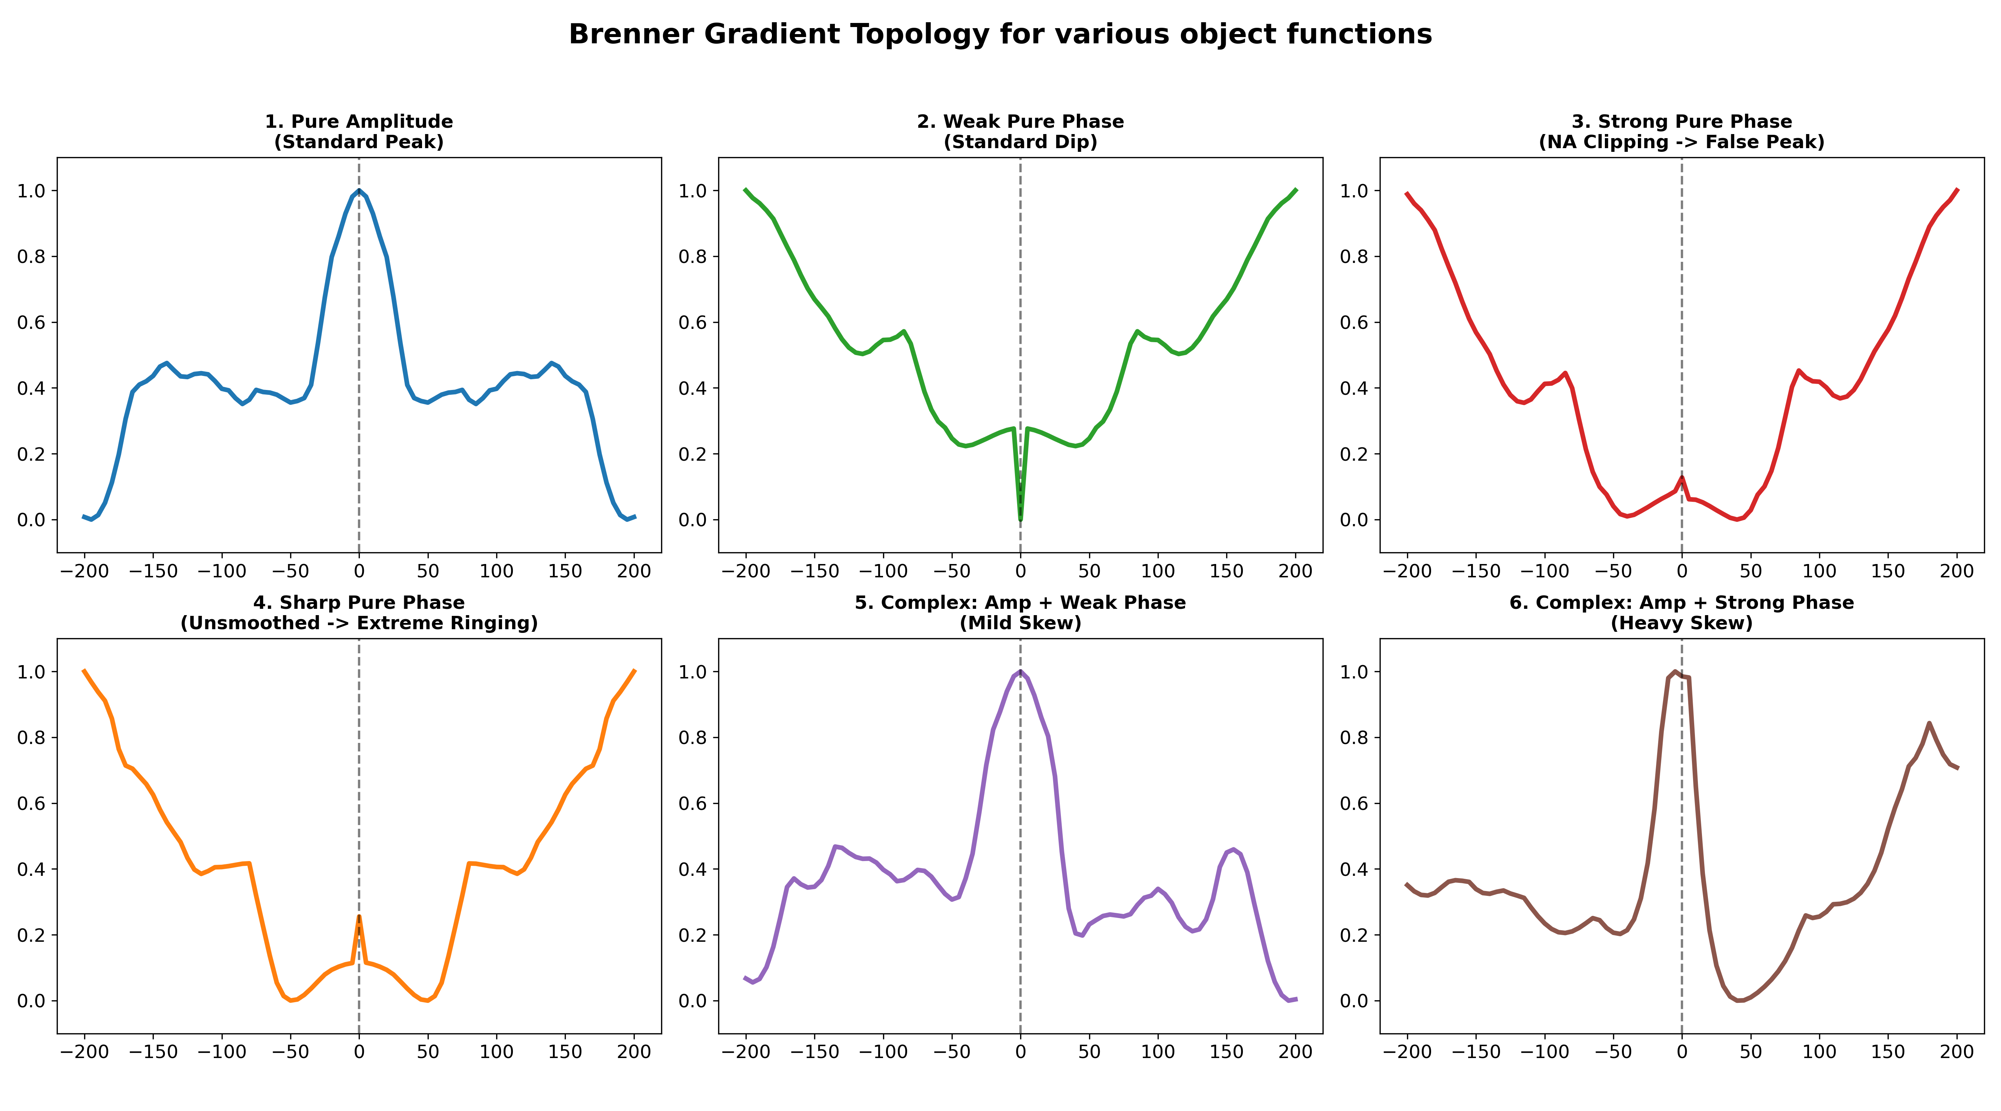
A
Pure Amplitude
B
Pure Phase (weak)
C
Pure Phase (strong)
D
Complex Object
Global
maximum
Asymmetry
Normalized Brenner score
Global
minimum
False peak
Defocus (um)
Defocus (um)
Defocus (um)
Defocus (um)

Slide 4
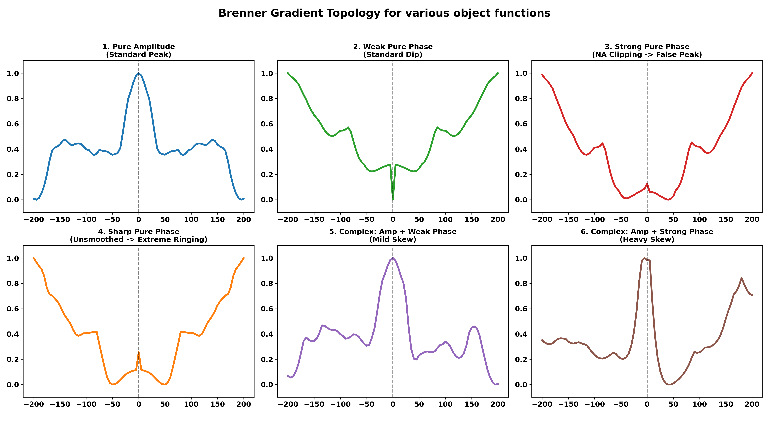
(a)
Pure Amplitude
(b)
Pure Phase (weak)
(c)
Pure Phase (strong)
(d)
Complex Object
Global
maximum
Asymmetry
Normalized Brenner score
Global
minimum
False peak
Defocus (µm)
Defocus (µm)
Defocus (µm)
Defocus (µm)

